Slide 1
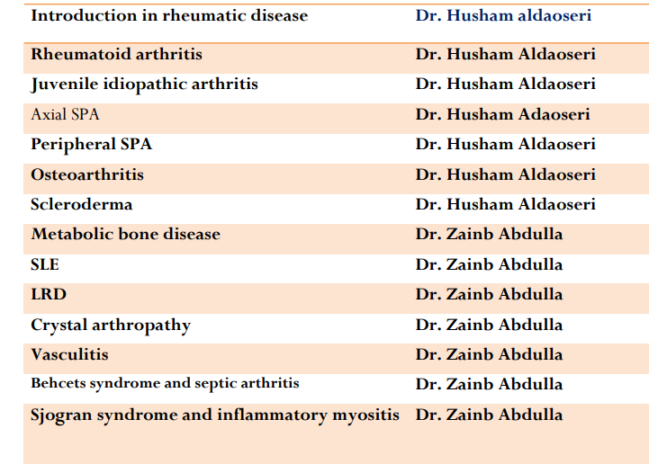
The rhrumatological lectures schedule for 5th year 2023-2024

Slide 2
INTRODUCTION TO RHEUMATOLOGY

Slide 3
What is Rheumatology
A medical science devoted to the study of rheumatic diseases and musculoskeletal disorders.

Slide 4
Approximately 30% of the U.S. population has arthritis and/or back pain.
One out of every five office visits to a primary care provider and 10% of all surgeries are for a musculoskeletal problem.
Arthritis/back pain is the second leading cause of acute disability, the number one cause of chronic disability.
Most common reason for social security disability payments.

Slide 5
Classification of Joints
Fibrous
Fixed
(Synarthrosis)
Cartilaginous
Slightly movable
(Amphiarthrosis)
Synovial
Freely movable
(Diarthrosis)
1. Plane
2. Hinge
3. Pivot
4. Bicondylar
5. Saddle
6. Ball and socket
Sutures
B. Syndesmosis
Pri. Cart. joints
(Synchondrosis)
B. Sec.cart. Joints
(Symphysis)

Slide 6
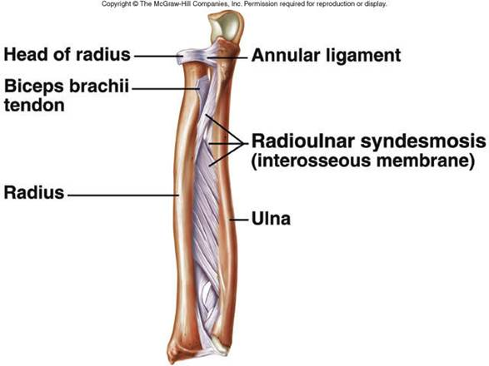
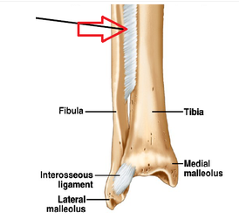
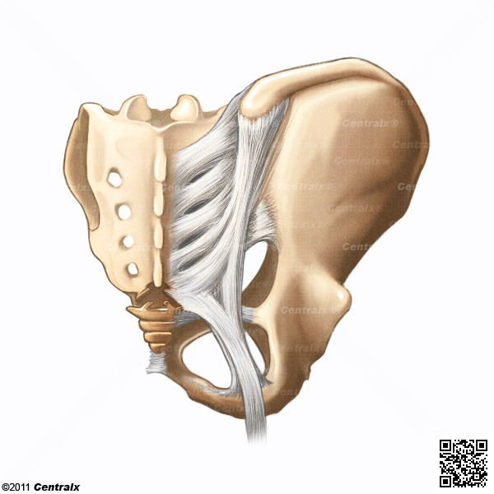
SYNDESMOSIS
Fibrous connection between bones

Slide 7
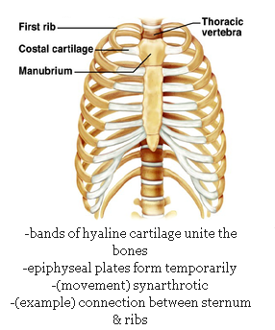
CARTILAGINOUS JOINT
1. Primary Cartilaginous Joint
Also called as synchondrosis

Slide 8
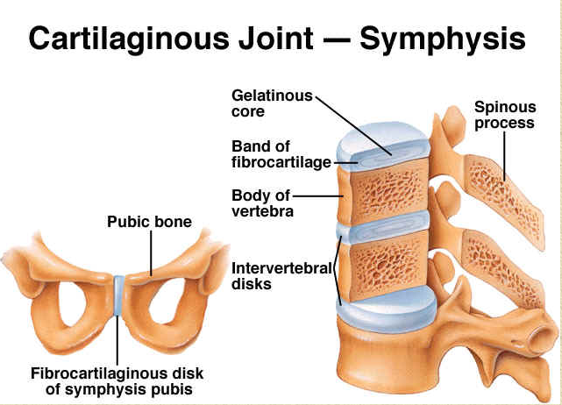
CARTILAGINOUS JOINT
2. Secondary Cartilaginous Joints
Also called as symphysis

Slide 9
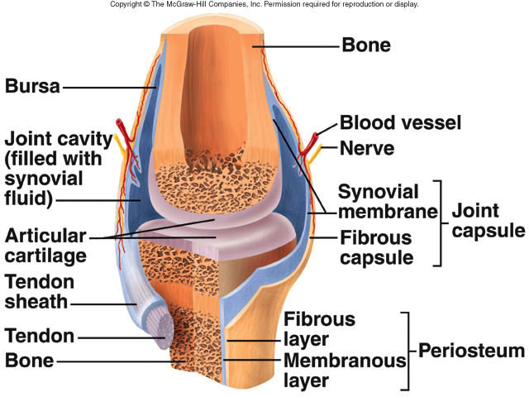
SYNOVIAL JOINT
Most evolved joint.
Freely
movable joint.
Possess a joint cavity that consists of synovial
fluid.

Slide 10
Approach to the Patient with Joint Symptoms
Clinical Presentation
 A careful history and detailed physical examination
should be directed at answering the following five key diagnostic questions:
 Is the process truly articular?
 Is the process inflammatory or mechanical?
 What is the pattern of joint involvement?
 Are there extra-articular manifestations?
 Who is the host?

Slide 11
Features that suggest an articular process
 Symptoms (pain) localized to the joint(s)
 Physical findings (swelling, erythema, heat, or tenderness)
 Joint range of motion is painful
 Joint range of motion is restricted

Slide 12
Features that suggest an inflammatory process
Morning stiffness longer than 60 minutes (versus
worsening in the evening in mechanical processes)
 Gel phenomenon (stiffness after prolonged inactivity)
 Symptoms improve with use (versus worsening with use in mechanical processes)
Joint swelling, erythema, heat, or tenderness
 Active constitutional manifestations (e.g., fever, malaise, anorexia or weight loss)

Slide 13
Relevant patterns of joint involvement
 Acute onset (e.g., microcrystalline) versus insidious onset (e.g., osteoarthritis ) Episodic (e.g., microcrystalline) versus migratory (e.g., disseminated gonococcal infection and acute rheumatic fever) versus additive (e.g., rheumatoid arthritis )
 Monoarticular (e.g., microcrystalline and septic)
versus oligoarticular (e.g.,Peripheral SPA) versus polyarticular (e.g., RA)
 Symmetrical (e.g., RA) versus asymmetrical e.g., Peripheral SPA

Slide 14
Relevant extra-articular features
 Constitutional symptoms and signs (i.e., presence of a
fever)
 Mucocutaneous (e.g., photosensitive and other cutaneous
eruptions, alopecia, mucosal aphthous ulcers,
and Raynaud’s phenomenon)
 Ocular (e.g., conjunctivitis, episcleritis, scleritis, and
uveitis)
 Renal (e.g., glomerulonephritis, renal tubular acidosis,
and nephrolithiasis)

Slide 15
 Neurologic (e.g., focal central and peripheral nerve
disease, seizures, and cognitive and psychiatric disorders)
 Pulmonary (e.g., nodules, infiltrates, interstitial fibrosis,
pulmonary embolism and hypertension, alveolar
hemorrhage, bronchiolitis, and pleuritis)
 Gastrointestinal (e.g., inflammatory bowel disease and
autoimmune liver disease)
 Hematologic Anemia (e.g., anemia of “chronic disease” and hemolytic anemia) Leukopenia (e.g., neutropenia in Felty syndrome and lymphopenia in systemic lupus erythematosus (SLE) Thrombocytopenia (e.g., SLE with antiphospholipid antibodies)

Slide 16
Relevant host factors
 Age
 Gender
 Race
 Comorbidities
 Occupational exposures
 Family history

Slide 17
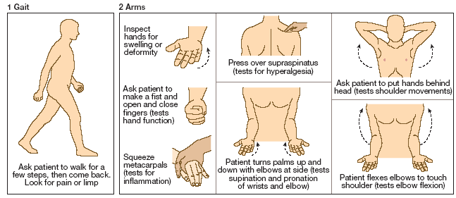
Diagnosis and Evaluation

Slide 18
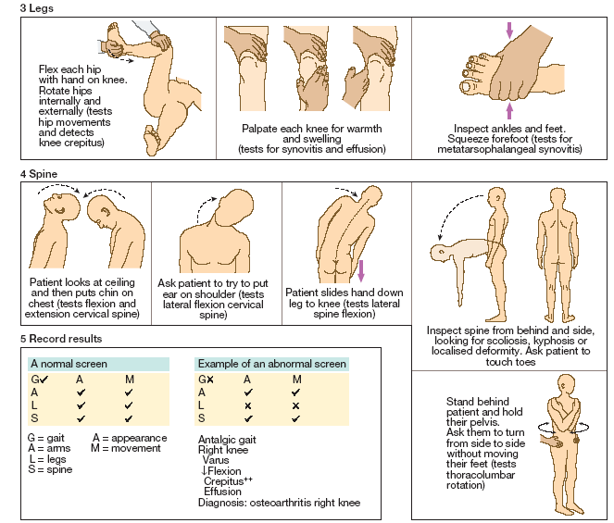

Slide 19
Investigation of Musculoskeletal disease
Obtain relevant laboratory studies as indicated
 Kidney and liver function
 Complete blood count with leukocyte differential
 Urinalysis
 Erythrocyte sedimentation rate and C-reactive protein
 Thyroid function
 Autoantibodies

Slide 20
Obtain and evaluate synovial fluid as indicated
 Check synovial fluid leukocyte cell count, Gram stain and culture, and polarized microscopy for crystals
 White blood cell (WBC) count less than 200/mm³
(normal), greater than 2000/mm³ (inflammatory), and greater than 100,000/mm³ (presumptively septic)

Slide 23
Obtain relevant imaging studies
 Conventional radiography is the starting point in
imaging studies due to widespread availability, low
cost, and high resolution, but may reveal only nonspecific
soft tissue swelling in early inflammatory disease
 Computed tomography (CT) is widely available and
a good choice for assessment of the spine and pulmonary
parenchyma
 Magnetic resonance imaging (MRI) has replaced CT
in many situations (e.g., disc herniation, sacroiliac
joints, osteonecrosis, and synovitis)

Slide 24
 Arthrography (e.g., evaluation for rotator cuff tears)
 Angiography (e.g., evaluation for vasculitis)
 Both mechanical and inflammatory joint disease cause increased tracer uptake so that nuclear medicine scans have a limited role in the evaluation of arthritis
 Ultrasound is useful in differentiating thrombophlebitis from pseudothrombophlebitis (ruptured Baker cyst), with an expanding role in the assessment of synovitis and erosive joint disease

Slide 25
Dual energy X-ray absorptiometry (DXA)
Bone mineral density (BMD) measurements play a key role in the diagnosis and management of osteoporosis.

Slide 26
